Slide 1
Biosimilars
بسم الله الرحمن الرحیم
Dear Students,
You can study the “Notes” section in this PowerPoint for the exam.
Please don't hesitate to contact me if you have any questions.
Contact information:
Email: iranunistudents@gmail.com
Negar Mottaghi-Dastjerdi
Pharm. D, Ph. D in Pharmaceutical Biotechnology
School of Pharmacy, Iran University of Medical Sciences

Slide 2
Biosimilar
A biosimilar is a biological medicine highly similar to another already approved biological medicine (the 'reference medicine').
Biosimilars are approved according to the same standards of pharmaceutical quality, safety, and efficacy that apply to all biological medicines.
The European Medicines Agency (EMA), FDA, and IFDA are responsible for evaluating the majority of applications to market biosimilars in the European Union (EU) and the U.S. and Iran, respectively.

Slide 3
Biological medicines: overview
Biological medicines (‘biologicals’) contain active substances from a biological source, such as living cells or organisms.
Biological medicines are well established in clinical practice and in many cases, they are indispensable for the treatment of serious and chronic conditions such as diabetes, autoimmune diseases, and cancers.

Slide 4
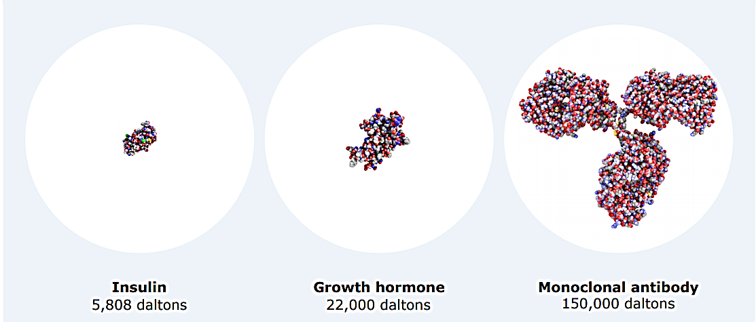
Key features of biological medicines
Most biological medicines in current clinical use contain active substances made of proteins. These can differ in size and structural complexity, from simple proteins like insulin or growth hormone to more complex ones such as coagulation factors or monoclonal antibodies.

Slide 5
Key features of biological medicines
Biomanufacturing strictly regulated
Large molecular structure
Inherent degree of variability
Strict control of the quality of biological medicines
Physicochemical properties
Biological activity
Purity
Sterility
Stability
Potential immunogenicity
Notes:
Biomanufacturing strictly regulated
The manufacture of biological medicines tends to be more complex than chemically-derived molecules. Most biological medicines are made by biotechnology, often using sophisticated cell systems and recombinant DNA technology. The EU legislation imposes strict requirements for the manufacture of all medicines: EU manufacturers must hold a manufacturer’s license and are legally obliged to comply with Good Manufacturing Practice (GMP), the agreed standards to obtain a medicine with proven quality. National regulatory authorities in the EU regularly inspect manufacturing sites for compliance with GMP requirements. If some manufacturing steps take place outside the EU, then non-EU manufacturers, importers, and wholesale distributors are obliged to follow the same strict requirements and are also regularly inspected. For biological medicines, some of the GMP requirements have been adapted to take into account their specific nature (e.g., use of appropriate aseptic techniques, refrigeration, and other storage conditions, stability, transport, etc.)
Large molecular structure
Compared with small chemical substances, biological medicines consist of large and often complex molecular structures. Sophisticated analytical methods (e.g., Peptide mapping, mass spectrometry, and assays in cells) are used to study their physicochemical and functional properties such as molecular structure, protein modifications and biological activity.
Inherent degree of variability
Biological medicines are made by living organisms, which are naturally variable. Thus, the active substance in the final biological medicine can have an inherent degree of minor variability (‘microheterogeneity’). This minor variability must fall within the acceptable range to ensure consistent safety and efficacy. This is done by adjusting the manufacturing process to guarantee that the active substance fits into the desired specifications range. This degree of minor variability can be present within or between batches of the same biological medicine, particularly when manufacturing processes are modified during the commercial life of the medicine (e.g., increasing production scale). Strict controls are always applied to ensure that, despite this variability, there is batch-to-batch consistency and that the differences do not affect safety or efficacy. In practice, variability (within a batch or batch-to-batch) is very low when using the same manufacturing process.
The strict control of the quality of biological medicines
The quality of all medicines (biological and nonbiological) approved in the EU is rigorously proven. For biological medicines, this includes studying their specific physicochemical properties, biological activity, purity, sterility, and stability to ensure that all the required standards are met before batches are released for marketing.
Potential immunogenicity
The immune system has the ability to recognize foreign proteins and react against them. Biological medicines usually cause no or only a limited immune response (e.g., the transient appearance of antibodies). Adverse reactions of an immune nature (e.g., infusion-related reactions or injection-site reactions) are normally not severe. Rarely, however, an immune reaction against a biological medicine could be serious and life-threatening. Also, antibodies directed against the biological medicine (‘anti-drug antibodies or ADAs) could neutralize the medicine’s activity and reduce its efficacy. Thus, potential immunogenicity needs to be always evaluated for all biological medicines.

Slide 6
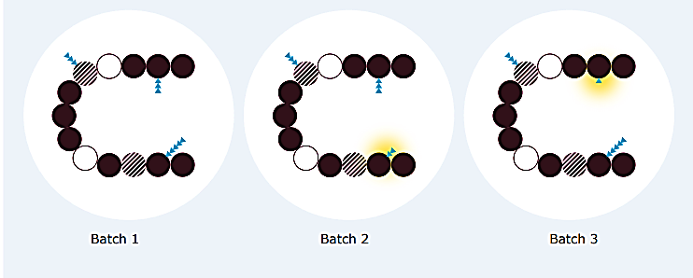
Example of variability between different batches of a biological medicine
Notes:
Consecutive batches of the same biological medicine may show a small degree of variability (yellow shadow) within the accepted ranges, for example in glycosylation (sugar molecules attached to the protein, which are represented by small blue triangles). The amino acid sequence (represented by circles) and biological activity of the protein remain the same in all batches, even when these minor differences in sugar chains are present.

Slide 7
Biosimilar medicines
A biosimilar medicine (‘biosimilar’) is a medicine highly similar to another biological medicine already marketed in the EU, FDA, etc. (the so-called ‘reference medicine’).
Companies can market approved biosimilars once the period of market protection of the reference medicine expires (after 10 years).

Slide 8
Features of biosimilars
Since biosimilars are a type of biological medicine, all features pertinent to biological medicines apply.
Due to the natural variability of the biological source and to the manufacturing process unique to each manufacturer, minor differences can occur between the biosimilar and its reference medicine.
Strict controls are always in place during manufacturing to ensure that minor differences do not affect the way the medicine works or its safety.
Thus, these differences are not clinically meaningful in terms of safety or efficacy.

Slide 9
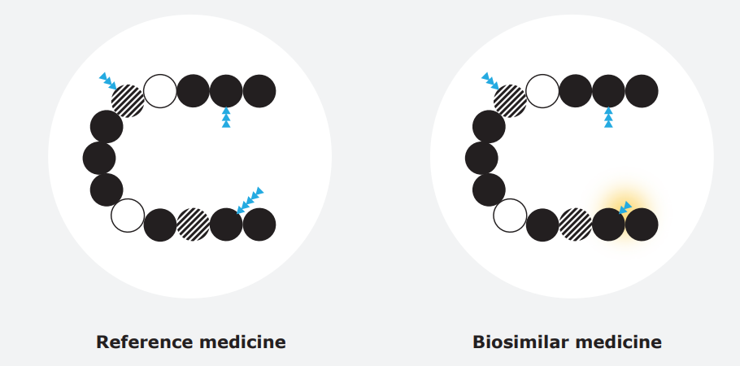
Example of variability between a biosimilar and the reference medicine
Notes:
Variability (yellow shadow) between a biosimilar and the reference medicine is comparable to what may occur between different batches of the same biological medicine. Minor variability, e.g. in glycosylation (represented by small blue triangles) may be allowed, while the protein’s amino acid sequence (circles) and biological activity are the same.

Slide 10
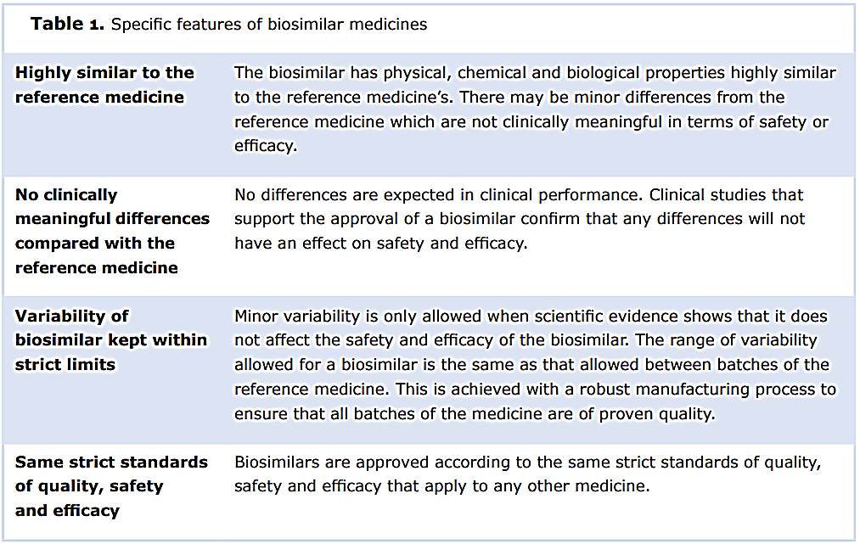

Slide 11
Biosimilar vs Reference
When the active substance is a protein, both the biosimilar and the reference medicine must contain the same protein (i.e., amino acid sequence) and the same ‘3D’ structure (folding of the protein).
Amino acid sequence and folding are the main factors that determine biological activity, which must be the same for the biosimilar and the reference medicine.
For the finished medicine, both biosimilar and reference medicine must have the same posology and route of administration.
Some differences may be allowed if they have no effect on safety and efficacy - for example, differences in
the formulation of the medicine (e.g., excipients),
presentation (e.g., powder to be reconstituted versus solution ready for injection), and
administration device (e.g., type of delivery pen)

Slide 12
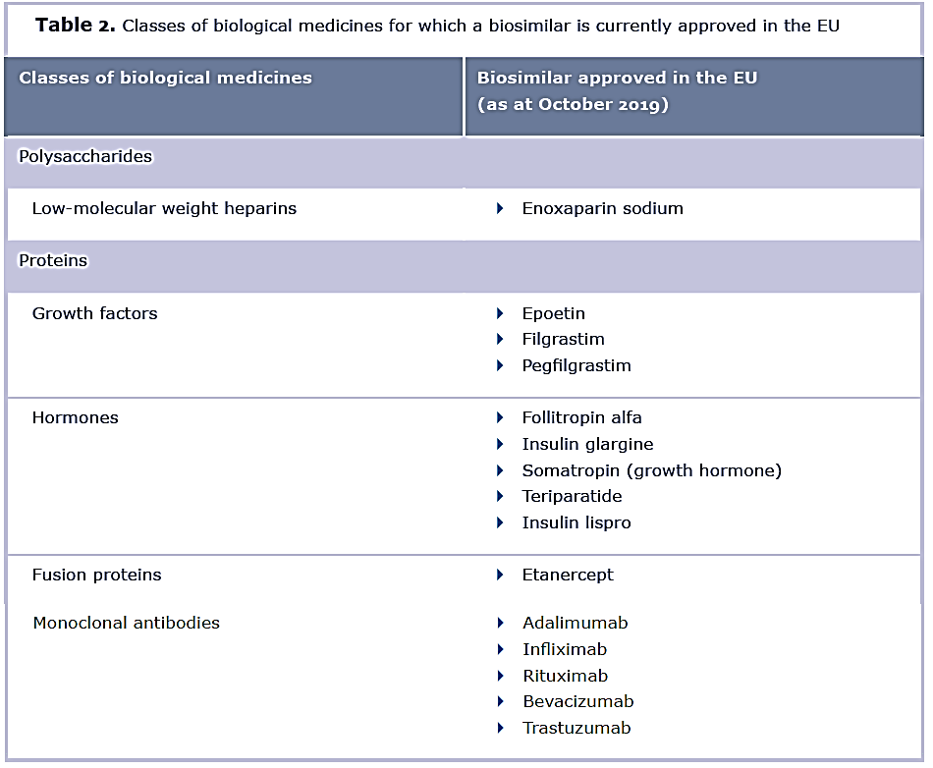
Notes:
To date, the great majority of approved biosimilars contain proteins as active substances.
Table lists the classes of biological medicines for which biosimilars have been approved in the EU

Slide 13
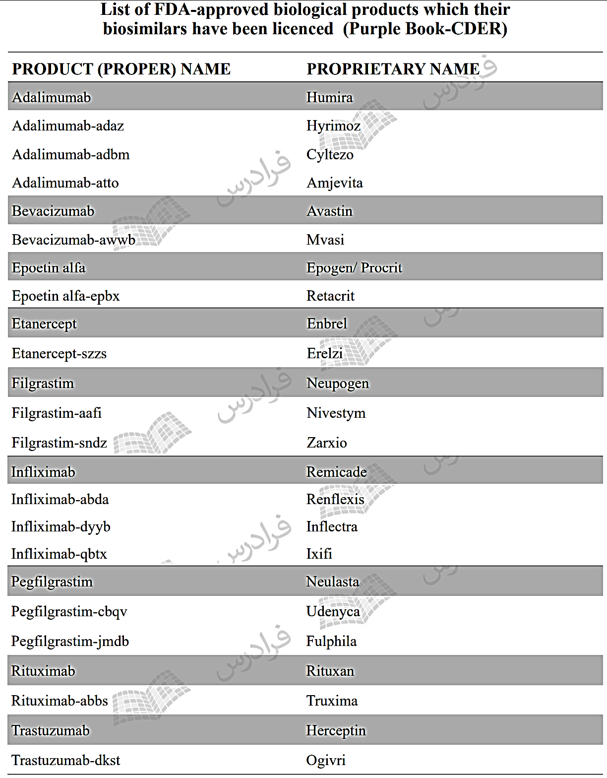
Ref: Faradars, Biosimilars
Notes:
Center for Drug Evaluation and Research | CDER | FDA

Slide 14
Naming of biosimilars Ref: Nonproprietary Naming of Biological Products (FDA guideline)
Biosimilars must be named with a unique identifier: a four-letter suffix is added to the name of the reference product.
This nomenclature helps to distinguish reference products from their respective biosimilars and among non-interchangeable biological products.
[Refer to the previous slides entitled: “List of FDA-approved biological products which their biosimilars have been licensed (Purple Book-CDER)”]

Slide 15
Why biosimilars are not considered generic medicines
A biosimilar is not regarded as a generic of a biological medicine. This is mostly because the natural variability and more complex manufacturing of biological medicines do not allow an exact replication of the molecular microheterogeneity.
Consequently, more studies are needed for regulatory approval of biosimilars than for generics to ensure that minor differences do not affect safety or efficacy.
The tables in the next two slides compare the development and characteristics of generics and biosimilars.

Slide 16
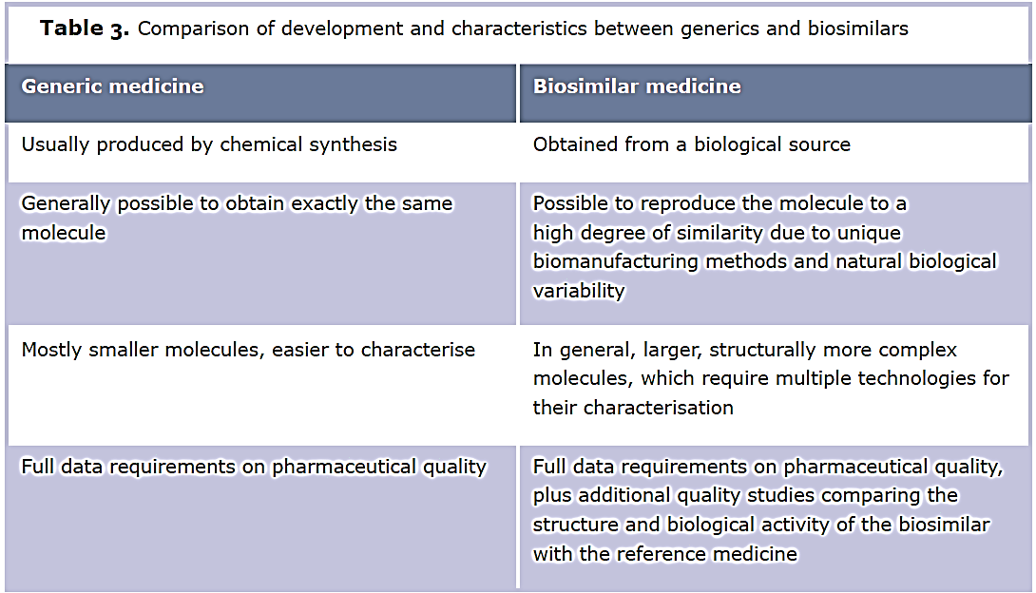

Slide 18
Development and approval of biosimilars in the world

Slide 19
Comparison of the drug development programs in biosimilars vs traditional drugs
The goal of a biosimilar development program differs from a traditional drug development program.
The goal of a drug development program is to demonstrate that the product is safe and effective for one or more indications.
The objective of a biosimilar development program is to demonstrate that the biosimilar product is highly similar to an already-licenced reference product.
In general, less than $5 million and 3-5 years are needed to develop a generic, small-molecule drug.
More than $100 million and 8-10 years are needed to develop a biosimilar.
Because of differences in development and manufacturing, the laws and statutes that regulate biologic agents are different than those that pertain to small molecule drugs.
Although the overarching goals and requirements of approval are the same for small drugs and biologic agents, biologics require additional determinations owing to their complexities.
Legally, biologic agents and biosimilars can have slight differences from the reference drug.
Biosimilars are expected to have the same safety, efficiency, and risk/benefit profile as their reference product.

Slide 20
Regulation of biosimilars worldwide
Biosimilars are approved according to guidelines and recommendations of the EMA, FDA, Health Canada, and WHO.
Europe has a longer history with the use of biosimilars than the U.S. and approved the first biosimilar product nearly 10 years the first U.S. approval.
In 2003, the legal pathway for authorizing biosimilar medicines was established in Europe.
In 2006, Europe’s first biosimilar product, somatotropin, was approved.
Dozens of biosimilar products have since been approved in Europe, including hematopoietic growth factors (e.g. filgrastim and epoetin), insulin, somatropin, follitropin, and infliximab.

Slide 21
EU contribution to the regulation of biosimilars worldwide
The EU’s regulation of biosimilars has shaped biosimilar development globally, by establishing the core principles that underpin biosimilar development in other highly regulated areas of the world.
The requirements for biosimilar approval in the US by the FDA are based on the same scientific rationale as in the EU, although specific data requirements may differ between these two regions due to different legal frameworks. Other international regulators such as Australia’s TGA directly apply the principles set out in the EU legislation for the development and approval of biosimilars.
The World Health Organization (WHO) has developed its own guidelines for biosimilars (called ‘similar biotherapeutic products’ or SBPs) and biosimilar monoclonal antibodies, with the aim of providing guidance to regulatory agencies worldwide. These WHO guidelines incorporate many of the scientific principles used by EMA and its scientific committees in EU guidelines, as EU experts have been closely involved in the preparation of the WHO guidelines.
EMA continues to share the extensive experience gained in the EU on biosimilars with other regulators around the world and participates in a number of international forums such as the International Pharmaceutical Regulators Forum.

Slide 22
A robust regulatory framework for biosimilars
Approval of medicines in the EU relies on a solid legal framework, which in 2004 introduced a dedicated route for the approval of biosimilars. The EU has pioneered the regulation of biosimilars since the approval of the first one (the growth hormone somatropin) in 2006. Since then, the EU has approved the highest number of biosimilars worldwide and consequently has the most extensive experience of their use and safety.
Over the years, EMA has issued scientific guidelines to help developers conform to the strict regulatory requirements for approving biosimilars. The guidelines have evolved to keep pace with rapid advances in biotechnology and analytical sciences, and they take on board increasing experience of clinical use.
The expertise acquired over the last 18 years has enabled EU regulators to integrate experience-based knowledge with the initial science-driven concept. This has helped to shape current requirements for approval.

Slide 23
Process for approval of biosimilars in the EU
All medicines produced using biotechnology and those for specific indications (e.g. for cancer, neurodegeneration, and auto-immune diseases) must be approved in the EU through EMA (via the so-called ‘centralized procedure’).
Nearly all biosimilars approved for use in the EU have been approved centrally, as they use biotechnology for their production.
Some biosimilars may be approved at the national level, such as some low-molecular-weight heparins derived from the porcine intestinal mucosa.
When a company applies for marketing authorization at EMA, data are evaluated by EMA’s scientific committees on human medicines and on safety (the CHMP and PRAC), as well as by EU experts on biological medicines (Biologics Working Party) and specialists in biosimilars (Biosimilar Working Party).
The review by EMA results in a scientific opinion, which is then sent to the European Commission, which ultimately grants an EU-wide marketing authorization.

Slide 24
Data requirements for approval: a scientifically tailored package
Medicines are approved when studies on their pharmaceutical quality, safety, and efficacy convincingly demonstrate that the medicine’s benefits outweigh the risks (‘positive benefit-risk balance’).
For any biological medicine with a new active substance, a positive benefit-risk balance is determined mainly from the evidence of safety and efficacy in pivotal trials in humans, supported by solid pharmaceutical quality data and non-clinical data.
For biosimilars, a positive benefit-risk balance is based on demonstrating biosimilarity, i.e., that the active substance is highly similar to the reference medicine.
This is achieved via comprehensive comparability studies with reference medicine and on the basis of solid pharmaceutical quality data.
By demonstrating high similarity with the reference medicine, the biosimilar can largely rely on the efficacy and safety experience gained with the reference medicine.

Slide 25
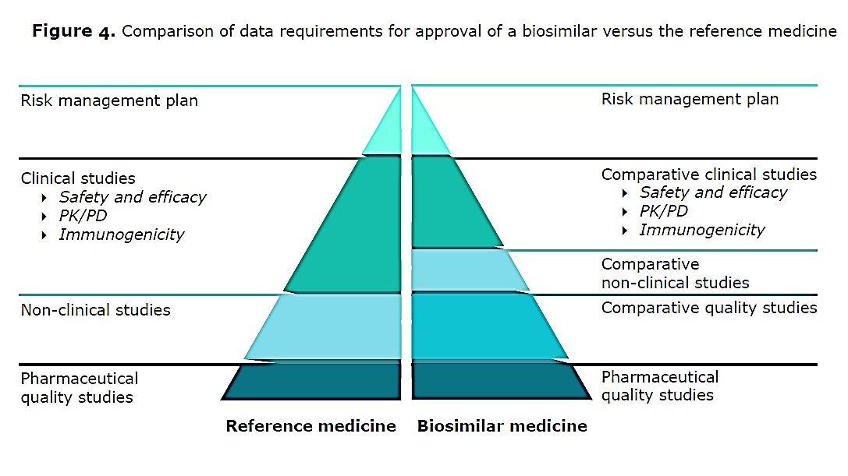

Slide 26
Data requirements for approval: a scientifically tailored package
The non-clinical and clinical data needed to approve a biosimilar are different from those needed for a biological medicine with a new active substance.
This is because, by demonstrating biosimilarity, the biosimilar relies on the safety and efficacy experience gained with the reference medicine.

Slide 27
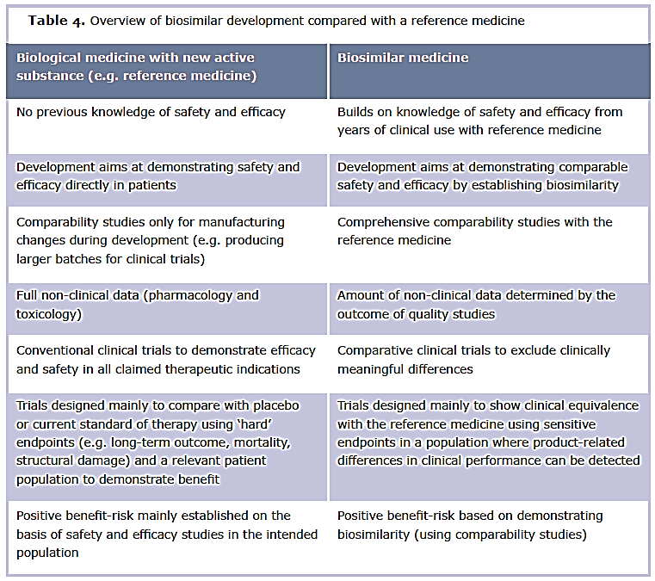

Slide 28
Same pharmaceutical quality standards for all medicines
Companies developing medicines in the EU, including biosimilars, must demonstrate with a large body of data that the medicine is manufactured to agreed standards and that it is suitable for its intended clinical use (what is known as ‘pharmaceutical quality’).

Slide 29
The studies to prove pharmaceutical quality should provide detailed data on:
Structural characterization and other physicochemical properties
Purity
traces of residues from the manufacturing process have to be controlled and must not exceed acceptable levels
Biological activity
Excipients and starting materials
Strength and formulation
Control of the manufacturing process
to ensure that the active substance and finished product conform with the accepted ranges for technical specifications
Stability of the active substance and finished product during shelf-life under defined storage conditions
Notes:
FYI: 2.4 Pharmacopoeial Specifications
Pharmacopoeias contain important requirements pertaining to certain analytical procedures and acceptance criteria, which, where relevant, are part of the evaluation of either the drug substance or drug product. Such monographs, applicable to biotechnological and biological products, generally include, but are not limited to tests for sterility, endotoxins, microbial limits, volume in container, uniformity of dosage units and particulate matter. With respect to the use of pharmacopoeial methods and acceptance criteria, the value of this guidance is linked to the extent of harmonisation of the analytical procedures of the pharmacopoeias. The pharmacopoeias are committed to developing identical or methodologically equivalent test procedures and acceptance criteria.

Slide 30
Comparability studies: the cornerstone of biosimilar development
Biosimilar development relies heavily on ‘comparability studies’ to establish biosimilarity to the reference medicine.
This involves a comprehensive head-to-head comparison of the biosimilar and the reference medicine.
Comparability is conceived as a step-wise process that is tailor-made for each product; knowledge from the initial quality comparability studies (step 1) is used to determine the extent and type of non-clinical (step 2) and clinical studies (step 3) required in the next step of development, always with the aim of ruling out differences in clinical performance between the biosimilar and the reference medicine.

Slide 31
Comparability studies: the cornerstone of biosimilar development
Comparability is a well-established scientific principle of regulatory science: comprehensive comparative quality studies prove that physicochemical properties and biological activity are highly similar.
Comparative clinical and non-clinical studies that support the approval of a biosimilar rule out differences which may affect the medicine’s safety and efficacy.

Slide 32
Step 1 Comparative quality studies
In vitro studies compare the protein structure and biological function using sensitive techniques capable of detecting minor differences with clinical relevance between the biosimilar and its reference medicine.
These studies are much more sensitive than clinical trials for detecting such differences, as there is often variability among human subjects participating in trials.
Differences that may affect clinical safety, efficacy, or immunogenicity need to be further studied (e.g., in comparative non-clinical or clinical studies, steps 2 and 3).

Slide 33
Step 2 Comparative non-clinical studies
These studies include pharmacodynamic studies in vitro, which look at binding and activation (or inhibition) of physiological targets and immediate physiological effects in cells.
Pharmacodynamic studies in vivo (animal models) are only done if no suitable in vitro model exists.
In vivo toxicological studies are only required in certain cases, for example when the biosimilar is produced in a new type of cell or organism, or when the formulation includes new excipients not used previously.

Slide 34
Step 3 Comparative clinical studies
The aim of studies in humans is not to demonstrate safety and efficacy in patients, as these have already been established for the reference medicine.
Clinical trials are tailored to confirm biosimilarity and to address any questions that may remain from previous analytical or functional studies.

Slide 35
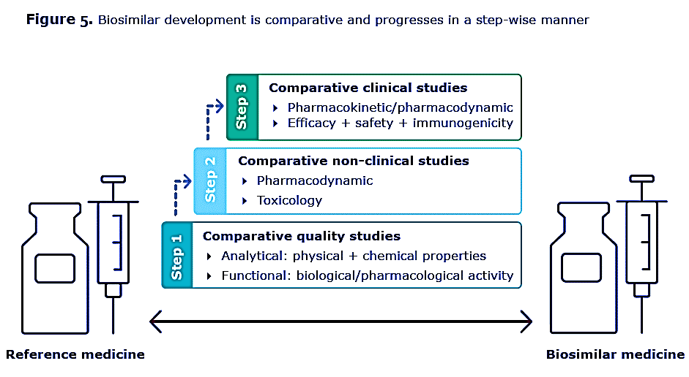

Slide 36
Approval of a biosimilar
Approval of biosimilars builds on existing scientific knowledge on the safety and efficacy of the reference medicine gained during its clinical use, so fewer clinical data are needed.
From a scientific and regulatory point of view, the reference medicine’s entire clinical development program does not need to be repeated.
This means that patients and healthy volunteers will not be subjected to unnecessary clinical trials.

Slide 37
Comparability: a scientific principle routinely used after manufacturing changes to medicines on the market
Comparability is not a new regulatory concept, but a well-established scientific principle that has been used for decades in the manufacture of medicines made by biotechnology. Companies producing biological medicines are likely to adapt or improve the manufacturing process several times during the commercial life of a product (e.g., by increasing production scale). Comparing batches before and after a manufacturing change ensures consistency so that there are no changes in safety or efficacy.
A change to the manufacturing process must always be approved by regulators. The extent of the comparability studies required following a manufacturing change to a biological medicine will depend on the expected impact on the quality, safety, and efficacy of the medicine. Most often, analytical and functional data are sufficient, and clinical trials to prove safety and efficacy are not needed (table in next slide, scenarios 1 and 2). Clinical trials are needed only if an impact on safety and efficacy is anticipated (scenario 3).

Slide 38
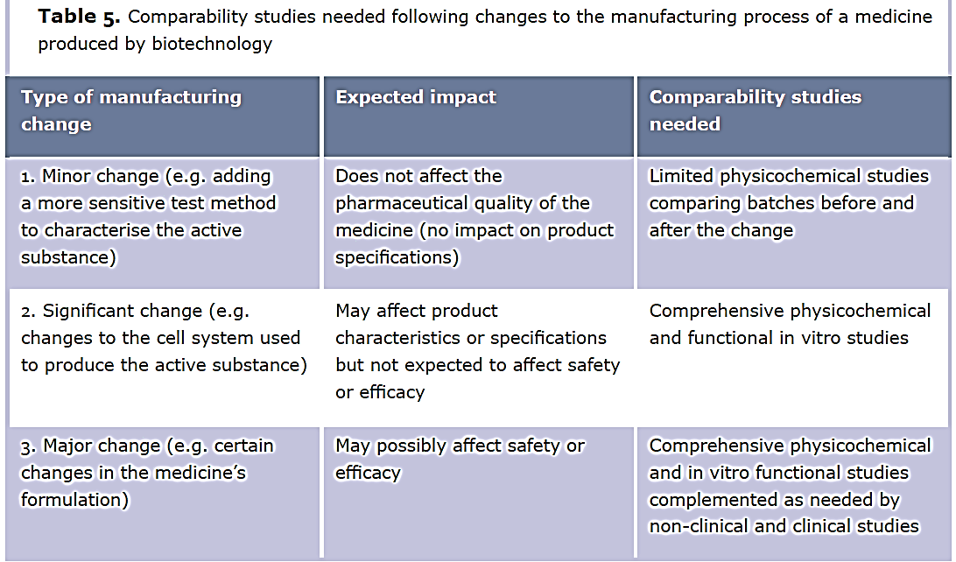

Slide 39
Summary of changes and their effects
Most of the widely used biological medicines on the market have seen several changes to their manufacturing process and these often result in minor differences from the version initially approved or the version used in the clinical trials filed for approval.
Regulators have built up the extensive experience to conclude that such differences do not affect the medicine’s quality, safety and efficacy.

Slide 40
Comparative trials are designed to confirm biosimilarity and clinical performance
Comparison of the biosimilar with the reference medicine involves extensive comparability studies to assess any possible impact on safety and efficacy.
The approach is equivalent to when major changes are introduced to the manufacturing process for a medicine made by biotechnology (scenario 3 in the previous table).
Clinical trials for biosimilars do not need to include all the pivotal studies conducted for the reference medicine to prove safety and efficacy in humans.
Comparative clinical trials are specifically designed to rule out clinically relevant differences in safety or efficacy between the biosimilar and the reference medicine, and to confirm biosimilarity.

Slide 41
Certain key aspects need to be considered for the design of comparative clinical trials:
The goal is to rule out potential product-related differences that could affect pharmacokinetics (PK), efficacy, or safety, including immunogenicity.
PK studies should be conducted in a homogeneous and sensitive population (healthy volunteers or patients) to detect any possible differences between the biosimilar and its reference medicine.
Healthy volunteers can be selected
If they represent the most appropriate population to detect such differences and
if the medicines’ toxicity is not a cause of concern.

Slide 42
Certain key aspects need to be considered for the design of comparative clinical trials:
To compare the pharmacological effects, a sensitive endpoint that allows detection of product-specific differences should be chosen.
Endpoints measuring pharmacodynamic activity (‘PD endpoints’) can be used when available and when relevant for the medicine’s clinical effect.
In many settings, these endpoints are more sensitive than clinical outcomes to detect potential differences between a biosimilar and the reference medicine.
PD endpoints are usually based on laboratory tests.
Examples include:
glucose infusion rate in a glucose clamp study for biosimilar insulins (rather than measures of HbA1c or long-term consequences of diabetes)
absolute neutrophil count for biosimilar granulocyte-colony stimulating factor (rather than number of serious infections)
number of oocytes retrieved during in vitro fertilization for biosimilar follicle-stimulating hormone (rather than pregnancies or live births)
Notes:
What is the glucose infusion rate?
Glucose infusion rate is a measure of how quickly the patient receives carbohydrates. Typically, this number should be less than 4 mg/kg/min in order to prevent hyperglycemia and steatos
The glucose infusion rate (GIR) represents the surrogate marker of the respective insulin pharmacodynamics. The GIR profile provides endpoints such as the maximal glucose lowering effect (GIRmax), onset and duration of action and biological efficacy as determined by the total area under the GIR curve (AUC-GIR).

Slide 43
Certain key aspects need to be considered for the design of comparative clinical trials:
If there are no suitable PD endpoints, a clinical efficacy trial comparing the biosimilar and its reference medicine is generally needed.
This trial should be adequately powered, randomized, parallel-group, preferably double-blind, and should use efficacy endpoints.
These endpoints should preferably measure the pharmacological activity of the medicine and be less influenced by the patient- or disease-related factors.

Slide 44
Certain key aspects need to be considered for the design of comparative clinical trials:
Adequate equivalence margins should be chosen for the primary efficacy endpoint.
Margins are established on the basis of knowledge of efficacy with the reference medicine, as well as on clinical judgment.
Equivalence margins are set specifically for the indication studied and depend on the endpoint chosen.
They should represent the largest difference in efficacy that would not matter in clinical practice; treatment differences within this range would thus be acceptable because they have no clinical relevance.
The principles of selecting equivalence margins are not unique to biosimilar testing:
they are routinely used in clinical trials when comparing treatment alternatives, or when comparing the same medicine before and after manufacturing changes that may have a clinical effect.
As for all clinical trials, legal requirements (e.g., Good Clinical Practice) have to be met.

Slide 45
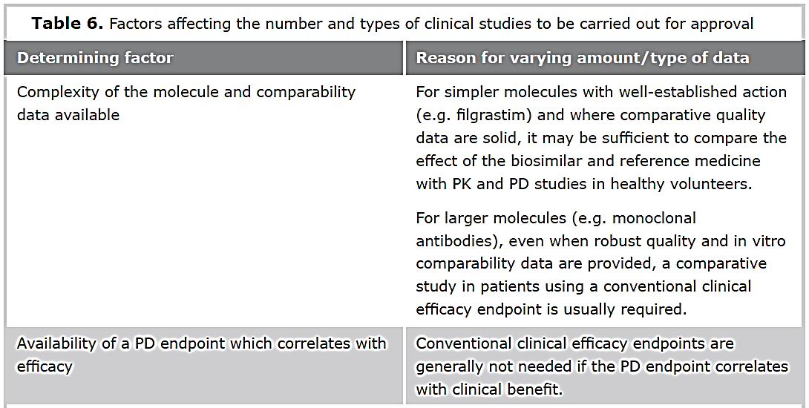

Slide 47
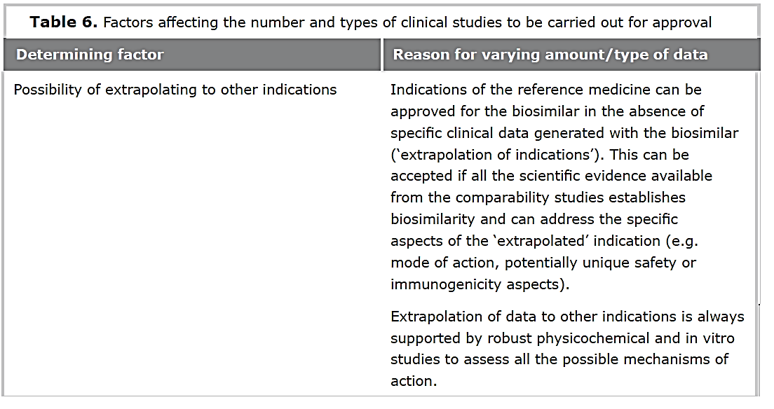

Slide 48
Amount of DATA needed
In addition to quality data, nonclinical and clinical data are required for any biosimilar, generated with the product itself.
The amount of such data that is considered necessary will depend
On the product or class of products,
On the extent of characterization possible using state-of-the-art analytical methods,
On observed or potential differences between the SBP and the RBP, and
On clinical experience with the product class (e.g. safety/immunogenicity concerns in a specific indication)
A case-by-case approach is clearly needed for each class of products.
A reduction in data requirements is therefore possible only for the nonclinical and/or clinical parts of the development program.

Slide 49
توسعه و تایید بیوسیمیلار در ایران
دستورالعمل سازمان غذا و داروی ایران: «ضابطه ثبت فراورده های بیولوژیک در ایران» مطابق با آخرین دستورالعمل سازمان غذا و داروی ایران
این ضابطه برای اجرای فرایند ثبت فراورده های بیولوژیک و آشنایی با مراحل و مستندات مورد نیاز برای درخواست ثبت در اداره بیولوژیک سازمان غذا و دارو کاربرد دارد.
مطابق قانون ورود و ساخت هر نوع دارو و یا فراورده بیولوژیک و عرضه و فروش آنها در داخل کشور و یا صدور آن به خارج از کشور مستلزم اجازه قبلی از وزارت بهداشت، درمان و آموزش پزشكی و اخذ پروانه و یا مجوز لازم می باشد.

Slide 50
انواع فراورده های بیولوژیک (مطابق با ضابطه ثبت در ایران)
واکسنها
فراورده های مشتق از پلاسما
ایمونوگلوبولینهای درمانی
فراورده های نوترکیب
آنتی بادیهای مونوکلونال
فراورده های بافت، سلول و ژن درمانی

Slide 51
انواع فراورده های نوترکیب و آنتی بادیهای مونوکلونال (مطابق با ضابطه ثبت در ایران)
داروی برند اصلی یا Original Brand یا Innovator Brand
داروی بیوسیمیلار
داروی بیوسیمیلار تولید داخل (LMB)

Slide 52
داروی برند اصلی یا Original Brand یا Innovator Brand (مطابق با ضابطه ثبت در ایران)
دارویی است که به عنوان داروی برند توسط سازمان های نظارتی کشورهای توسعه یافته از جمله FDA ،EMA ،TGA استرالیا و یا کشور ژاپن، برای اولین بار به ثبت رسیده است.

Slide 53
داروی بیوسیمیلار (مطابق با ضابطه ثبت در ایران)
داروی بیوسیمیلار به فرآورده بیولوژیكی گفته می شود که دارای ماده موثره یكسان با داروی برند اصلی بوده و از لحاظ کیفیت، ایمنی و اثر بخشی مشابه آن و قابل جایگزینی درمانی با آن باشد. داروی بیوسیمیلار بر مبنای اثبات تشابه یا similarity آن با داروی برند اصلی توسط سازمان های نظارتی کشورهای توسعه یافته از جملهFDA ، EMA ،TGA استرالیا و یا کشور ژاپن به ثبت رسیده است. این داروها در بعضی از کشورهای جهان به نام Biologics on Follow و یا سایر اسامی مشابه نیز شناخته می شوند. سازمان جهانی بهداشت این دارو ها را به نام Similar Biotherapeutic Product (SBP) می شناسد. این داروها فقط در موارد اندیكاسیون های بالینی ثبت شده برای داروی برند اصلی قابل تجویز است.

Slide 54
داروی بیوسیمیلار تولید داخل یا Locally manufactured biosimilar (LMB) (مطابق با ضابطه ثبت در ایران)
این فراورده به داروی بیولوژیک گفته می شود که دارای ماده موثره یكسان با داروی برند اصلی بوده و از لحاظ کیفیت، ایمنی و اثر بخشی مشابه آن و قابل جایگزینی درمانی با آن بوده و توسط شرکت های داروسازی در داخل کشور تولید شده است. فرایند ارزیابی های کیفی، اثربخشی و ایمنی فراورده تولید داخل هیچ تفاوتی با داروی برند اصلی و بیوسیمیلار ندارد. این دارو فقط در موارد اندیكاسیون های بالینی ثبت شده برای داروی برند اصلی قابل تجویز است. تائید تشابه داروی بیوسیمیلار تولید داخل با داروی برند اصلی بر اساس آخرین راهنماهای سازمان جهانی بهداشت و زیر نظر سازمان غذا و داروی ایران انجام می گیرد.

Slide 55
Immunogenicity
Immunogenicity is always studied for biological medicines.
This is because of the intrinsic ability of proteins and other biological medicines to cause an unwanted immune response, which, in rare cases, could cause a serious adverse reaction (e.g., anaphylaxis or delayed hypersensitivity) or reduced efficacy.

Slide 56
Key considerations on potential immunogenicity of biological medicines
Immunogenicity is not a safety concern in itself
Severe reactions due to an increased immune response are very rare and most often an immune response against a biological medicine is not associated with clinical consequences (e.g., anti-drug antibodies could be transient).

Slide 57
Key considerations on potential immunogenicity of biological medicines
The nature of immune reactions depends on many factors
Immunogenicity may be influenced
by product characteristics
e.g., changes to the structure of the protein may occur during improper storage or transport, or proteins could form aggregates
by treatment-related factors
e.g., the risk may vary with subcutaneous versus intravenous administration or with continuous versus intermittent treatment regimen
by patient- or disease-related factors
e.g., age, genetic and immune status, or concomitant treatments

Slide 58
Key considerations on potential immunogenicity of biological medicines
Harmful immunogenicity is unlikely after manufacturing changes or after switching
Many biological medicines are intended for the long-term management of chronic conditions, and therefore, over time the patient may receive biological medicines with slight differences.
Experience shows that a harmful immune response is unlikely after a change to the manufacturing process of a biological medicine since comparability studies prove that the batch from the new process is of the same quality and free of impurities or aggregates that can trigger immunogenicity.
There is also no reason to believe that harmful immunogenicity should be expected after switching between highly similar biological medicines.

Slide 59
Key considerations on potential immunogenicity of biological medicines
Immunogenicity is always monitored post-marketing
The immunogenicity of biological medicines is always monitored by regulatory authorities once the medicine is on the market.
This is particularly important to learn of rare immune reactions that can only be detected after a long follow-up period in larger numbers of patients.

Slide 60
Immunogenicity data needed for approval of a biosimilar
Clinical immunogenicity studies are generally required for biological medicines.
In the case of monoclonal antibodies, they are always required, as it is more difficult to predict
the incidence of unwanted immunogenicity,
the characteristics of the immune response, or
the clinical consequences.
Such studies look both at
short-term immune responses
(e.g., infusion-related reactions), as well as
long-term
(e.g., delayed responses due to an evolving immune reaction).
Immunogenicity data required for approval include
Incidence, titer, and persistence of antibodies against the biological medicine (ADAs),
Neutralization assays
(because neutralizing antibodies may reduce the effect of the medicine),
Assessment of the clinical impact, and
Measures to manage the potential risk of immunogenicity
(e.g., special monitoring of immune-mediated adverse reactions or use of concomitant medication to mitigate infusion reactions).

Slide 61
Immunogenicity data needed for approval of a biosimilar
In general, the amount and type of data will depend on several factors, including:
- The type of biological medicine and its intended use
- Product characteristics:
the great majority of immunogenicity studies focus on how differences at the product level may affect an immune response. These include studying changes to the structure or minor variability in the protein (microheterogeneity), or how protein aggregation could occur due to components derived from the formulation or packaging.
- Previous knowledge of immunogenicity:
for biological medicines with a low immunogenicity profile (e.g., filgrastim), patients are usually tested for antibodies frequently at the beginning and at the end of the clinical study with a shorter follow-up period and routine pharmacovigilance measures to manage any potential risk. In cases where clinically relevant immunogenic responses have been observed (e.g., epoetins) immunogenicity testing is more frequent, there is a longer patient follow-up with intensified clinical monitoring, and specific post-marketing studies may be required.

Slide 62
Extrapolation
If a biosimilar is highly similar to a reference medicine and has comparable safety and efficacy in one therapeutic indication, safety and efficacy data may be extrapolated to other indications approved for the reference medicine.
This means that fewer clinical trials or no trials at all need to be carried out with the biosimilar in certain indications.
Extrapolation of data to other indications is always supported by scientific evidence generated in robust comparability studies (quality, non-clinical and clinical).
Extrapolation is a well-established scientific principle that has been used for many years, for example whenever a biological medicine with several approved indications undergoes major changes to its manufacturing process (e.g., new manufacturing site or development of new formulations).
The potential effect of these changes on biological medicine’s clinical performance is carefully evaluated with comparability studies (mainly quality and in vitro studies).
If clinical studies are needed, these are conducted in one relevant indication, and, based on all these data, extrapolation to the other indications is usually possible.
Extrapolation is not a new concept, but a well-established scientific principle used routinely when biological medicines with several approved indications undergo major changes to their manufacturing process.
In most of these cases, regulators approve manufacturing changes based on comparability studies and clinical trials are not repeated for all indications.

Slide 63
Criteria for extrapolation
Important considerations need to be borne in mind before an indication for a biosimilar can be approved based on extrapolated safety and efficacy data.
These include:
Mechanism of action
Relevant study population
Extrapolation across different clinical settings
Extrapolation of safety data
Extrapolation of immunogenicity data
Notes:
The scientific criteria for extrapolation of efficacy and safety data are supported by over 15 years experience of safe and effective use of biosimilars in the EU.
Extrapolation is also supported by regulators’ extensive experience in the routine evaluation of manufacturing changes for biologicals, most often without the need to repeat clinical studies in all indications.
Prescribers can have confidence in using biological medicines (including biosimilars) for all their approved indications, as all approved indications of a medicine are granted based on scientific evidence.

Slide 64
Criteria for extrapolation
Mechanism of action
The mechanism of action of the active substance should be mediated by the same receptor(s) in both the initial and the extrapolated indication.
If the mode of action of the active substance is complex and involves multiple receptors or binding sites (as is often the case with monoclonal antibodies), it may be difficult to establish the contribution of each receptor or binding site to each indication.
In this case, additional studies (non-clinical or clinical) will be needed to prove that the biosimilar and reference medicine will behave similarly in the extrapolated indication.

Slide 65
Criteria for extrapolation
Relevant study population
Comprehensive comparability studies must show that the biosimilar is highly similar to the reference medicine (by means of safety, efficacy, and immunogenicity data) in a key indication in a population in which potential differences in clinical performance can be detected.

Slide 66
Criteria for extrapolation
Extrapolation across different clinical settings
Data from a given indication (e.g., rheumatoid arthritis) may not be directly applicable in terms of safety or efficacy to an indication falling within another therapeutic area where the mode of action, posology, or, pharmacokinetics may be different (e.g., oncology).
In this case, additional studies may be needed.

Slide 67
Criteria for extrapolation
Extrapolation of safety data
Safety data can only be extrapolated after a comparable safety profile has been established for the biosimilar in one therapeutic indication.
If comparability is shown at structural, functional, pharmacokinetic, and pharmacodynamic levels, and efficacy is comparable, then adverse reactions due to the biosimilar’s pharmacological action can be expected to be the same and to occur at similar frequencies.

Slide 68
Criteria for extrapolation
Extrapolation of immunogenicity data
Extrapolation of immunogenicity data is not automatic, as it always requires justification.
This is because immunogenicity is determined by more than product-related characteristics.
Factors relating to patients (age, immune status), disease (comorbidities, concomitant treatments) or treatment-related factors (route of administration, length of exposure) also have to be considered.

Slide 69
Implications of the availability of biosimilars
Once the period of market protection of the reference medicine expires (usually 10 years), companies can market approved biosimilars. In general, it is expected that biosimilars will be introduced to the market at a lower price than their reference medicine. Thus, they are expected to be less costly for healthcare systems.
This is partly due to a tailored development program that builds on scientific knowledge gained with the reference medicine and so avoids unnecessary repetition of non-clinical and clinical studies. It can also be due to increased market competition.
The experience over the past 15 years indicates that biosimilar competition can offer advantages to healthcare systems, as having more treatment alternatives available is expected to improve patients’ access to biological medicines with proven pharmaceutical quality.

Slide 70
Interchangeability, switching, and substitution
In the context of biosimilars and reference medicines, it is important for healthcare professionals to be aware of the terminology to refer to interchangeability and substitution practices in the EU.
Interchangeability refers to the possibility of exchanging one medicine for another medicine that is expected to have the same clinical effect. This could mean replacing a reference product with a biosimilar (or vice versa) or replacing one biosimilar with another. Replacement can be done by:
Switching, which is when the prescriber decides to exchange one medicine for another medicine with the same therapeutic intent.
Substitution (automatic), which is the practice of dispensing one medicine instead of another equivalent and interchangeable medicine at pharmacy level without consulting the prescriber.

